Slide 1
DB corruption and recovery options of db2dart command
Speakers: Milind Dumbhare, Anugraha John
IBM Advance Db2 Support
Time: 30th March 2023 at 3-4 pm IST
Place – (https://ibm.webex.com/join/midumbha)

Slide 2
Corruption: Database corruption is errors when reading, writing, moving, or processing data inside a database. Database files are prone to corruption. No computer file is immune to corruption, so are the database files. Data corruption in Db2® can be the source of crashes, panics, or forced database shutdowns. For Db2 DB, page is the smallest unit of data transfer between main memory and any other auxiliary store, such as a hard drive. When Db2 loads a page from the disk to the buffer pool, the page is validated. If the page is found to be invalid, it can cause crash.

Slide 3
Logical and physical corruption In cases of logical corruption, the data is physically correct, but there is a mismatch between the Db2 read of page metadata and the actual contents of the page. For examples the index page pointing to an incorrect root, or an incorrect number of data slots on a data page. Logical corruption failures only occur during runtime. The root cause of logical corruption is often a database problem. Physical corruption refers to data that is physically damaged. For example, a database page contains nothing but zeroes. The root cause of physical corruption varies. Areas of interest include database bugs, file system bugs, operating system issues or hardware problems. Problem Determination: Corruption https://www.ibm.com/docs/en/db2/11.5?topic=overview-corruption https://developer.ibm.com/articles/dm-1208corruptiondb2/

Slide 4
Agenda
EMP and SMP Page Corruption
Data Page Corruption
Index Page Corruption
Transaction Log file Corruption

Slide 5
DB2 dumps bad page errors only for those pages it has tried to access. It does not necessarily mean that only those pages are corrupt. You need to explicitly check all pages in your database to find the extent of corruption, with the help of the db2dart and INSPECT commands.
db2dart command : can be used to verify the architectural correctness of databases and the objects within them. It can also be used to display the contents of database control files in order to extract data from tables that might otherwise be inaccessible. Note : db2dart is Only allowed when the database is offline.
Reference link: https://www.ibm.com/docs/en/db2/11.5?topic=commands-db2dart-database-analysis-reporting-tool

Slide 6
Here we have recreated some live corruption scenarios for your knowledge . So before that we need to have some information on the below 1)collect tablespace id and tablespace name use below query db2 "select b.TBSPACEID, substr(B.TBSPACE,1,15) tbsp_name from syscat.tablespaces B order by 1 with ur” 2)check the state of each tablespaces , db2 list tablespaces | grep State if its 0x0000 then its in normal state. 3)collect table id , schema, table details use , db2 "select b.TBSPACEID, substr(B.TBSPACE,1,15) tbsp_name , TABLEID, rtrim(substr(A.tabschema,1,10)) ||'.'|| rtrim(substr(A.tabname,1,15)) schema_table_name from syscat.tablespaces B left outer join syscat.tables A on A.TBSPACEID=b.TBSPACEID where a.type='T' and b.TBSPACE <> 'SYSCATSPACE' order by 1 with ur"

Slide 7
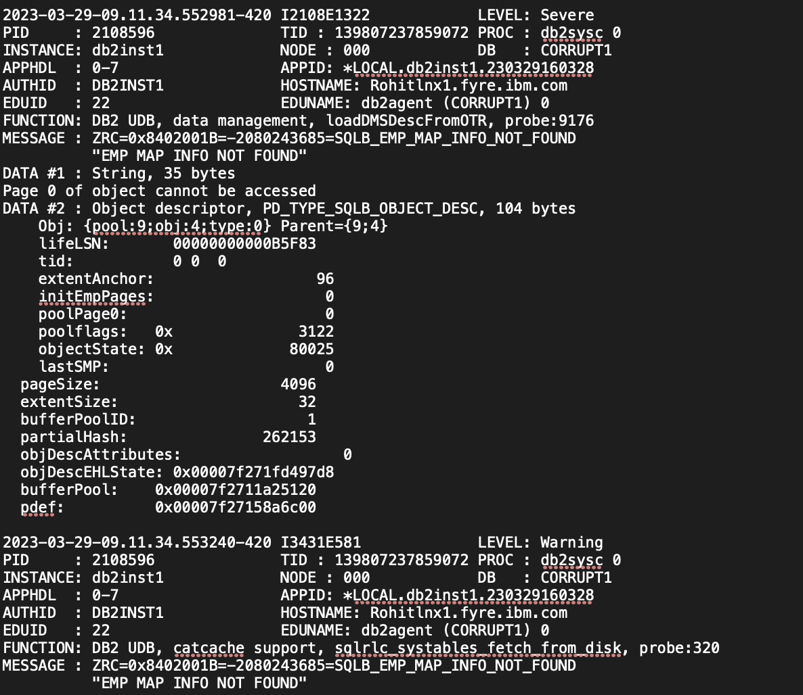
Tablespace EMP corruption: While issuing a select statement getting below error, Going through the db2diag.log ,

Slide 8
Reference : https://www.ibm.com/support/pages/node/501779
For EMP page corruptions, dropping and recreating the object is not possible since access to all EMP pages for the object is required to fully traverse it).
i) tablespace level restore and rollforward to end of logs.
ii) database level restore and rollforward to end of logs.
iii) If no database backup option available before corruption : drop all objects within the tablespace, drop the tablespace, recreate the tablespace, recreate all objects within the tablespace and repopulate all objects within the tablespace.
Try to retrieve data using
db2dart CORRUPT1 /DDEL
db2 drop tablespace TS7

Slide 9
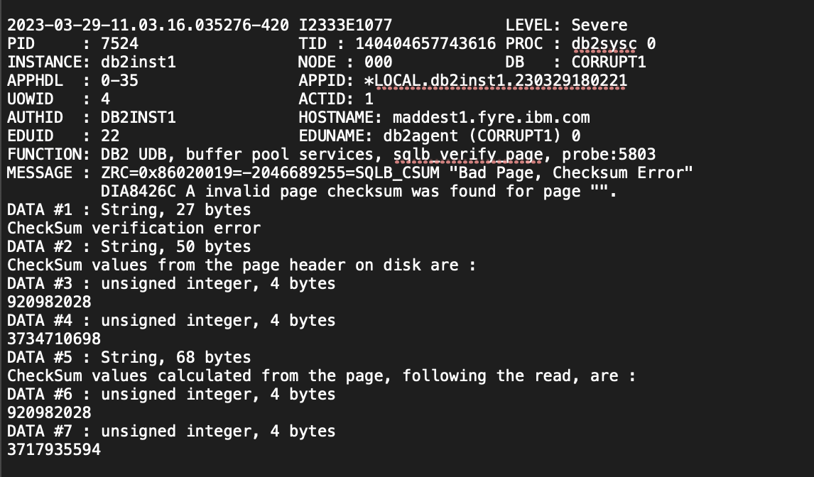
2. Table Corruption
While doing select operation getting below error ,
From the db2diag.log ,

Slide 10
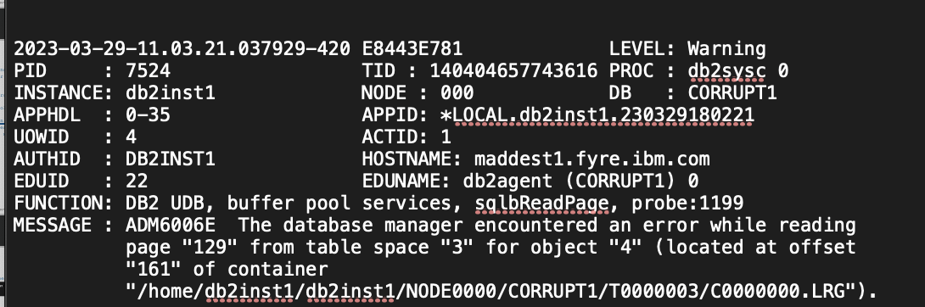
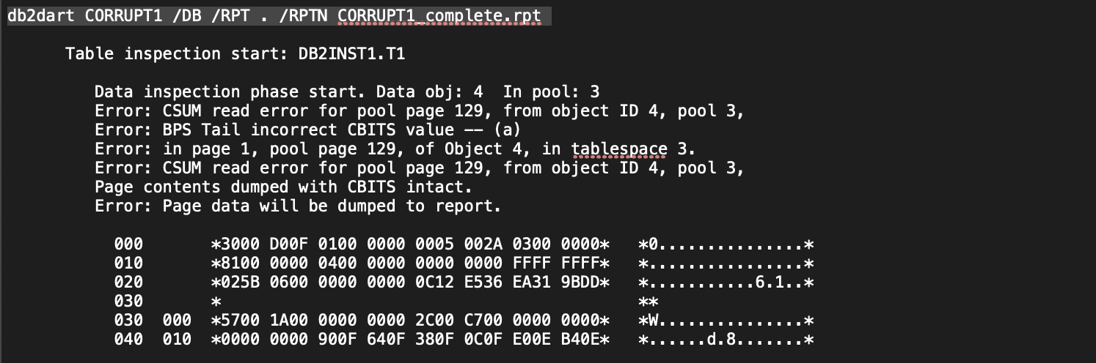
From the db2diag.log we can see that DB2 has encountered corruption on tablespace id 3
and object id 4 ,
Using db2dart , db2dart CORRUPT1 /DB /RPT . /RPTN CORRUPT1_complete.rpt

Slide 11
Corrupt Table Recovery Sample Steps for using /DDEL option Step1) Extract table DDL's > db2look -d <dbname> -t <schemaname>.<tablename> -e -xd -o tabname.look eg : db2look -d corrupt1 -t db2inst1.T2 -e -xd -o T2.look Please check if table ddl's captured in above tabname.look file and create new table with same DDL's by replacing old name with new table name Step2) Copy Data from original Table > db2dart <dbname> /DDEL eg : db2dart corrupt1 /DDEL Above command will ask for Table ID or name, tablespace ID, first page or logical row, num of pages or logical rows eg 4 3 0 9999999999999999 where 4 is table id , 3 is tablespace id, 0 is first page and 9999999999999999 last page Please keep same values for first page and last page as mentioned above. once command is executed please check table data in output file with del extension.

Slide 12
Step3) Edit db2look output file with new table name and execute it eg: DB2 -tvf tabname.look -o tabname.look_out Step4)Once the data is successfully copied(exported), We can now import the data in new table > db2 connect to <dbname> > db2 import from <Filename> of del modified by implicitlyhiddeninclude identitymissing insert into <new table name> eg: db2 import from t3.del of del modified by implicitlyhiddeninclude identitymissing insert into T2_backup Step5) verify it the data is completely copied or not > db2 "select * from <schemaname>.<Newtablename> with ur" Step6) If verification is done successfully then drop old table > db2 drop table <schemaname>.<tablename> Step7) Rename new table to Original table name > db2 rename <schemaname>.<newtablename> to <schemaname>.<originaltablename>

Slide 13
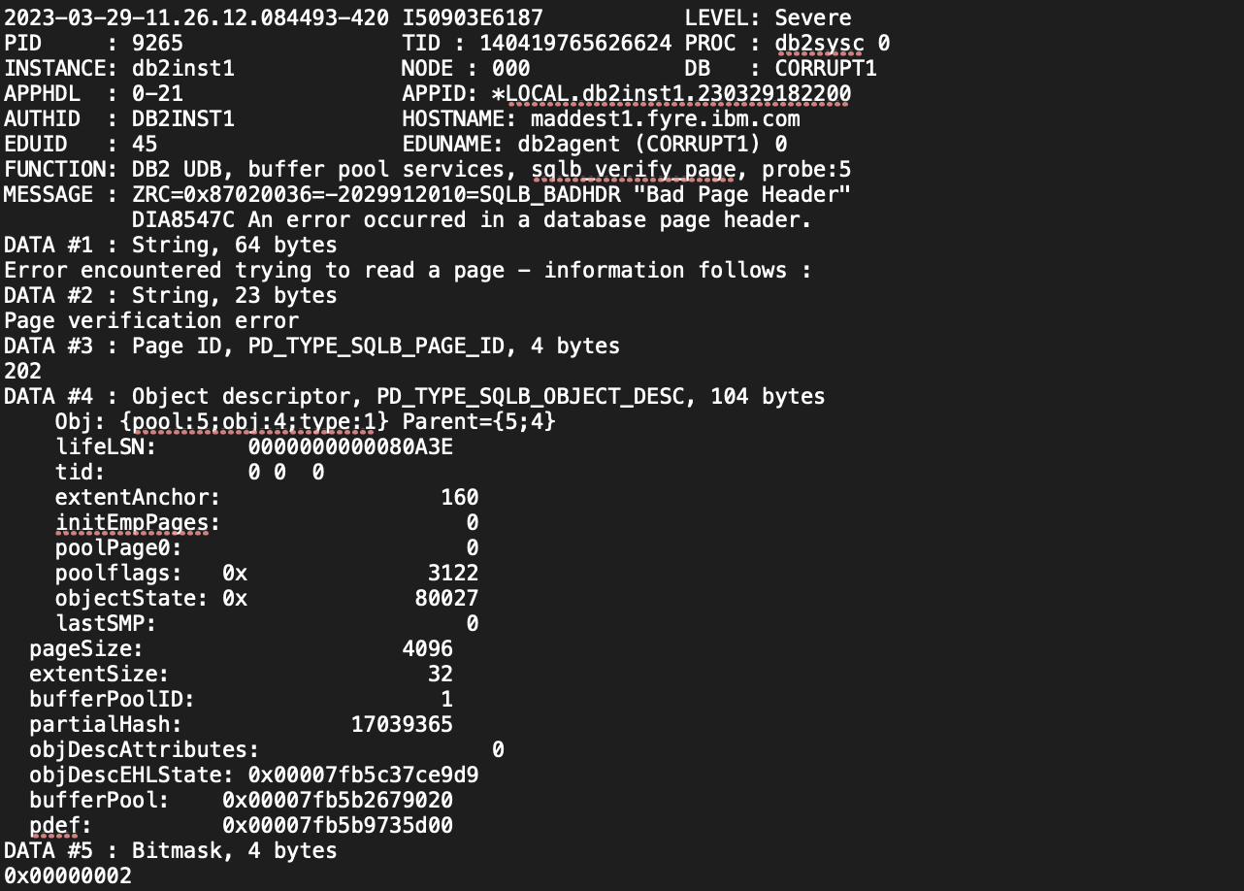
3. INDEX Corruption:
While doing select operation getting below error ,
From db2diag.log we could see below severe messages ,

Slide 14
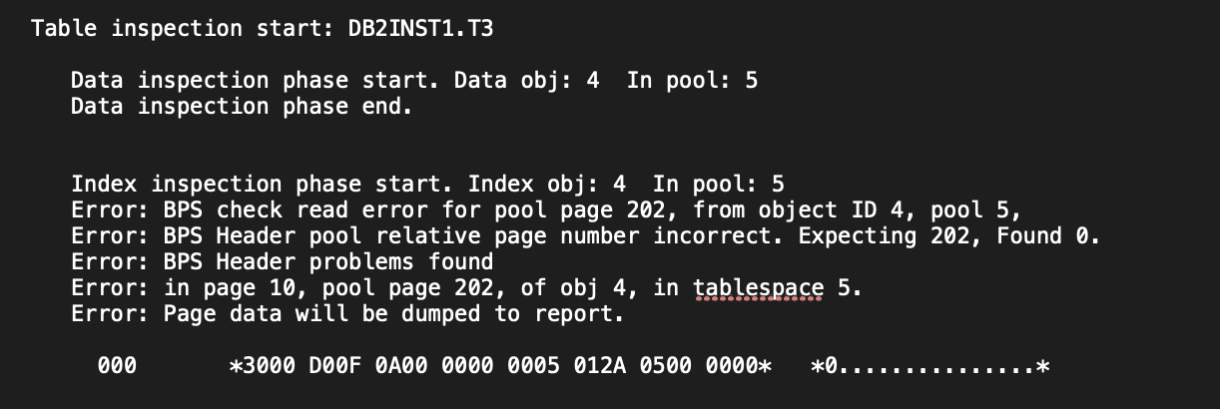
Corrupt Index Recovery : Mark index as invalid using db2dart .
db2dart <dbname> /MI /TSI <tablespace ID> /OI <object ID>
For our case its , db2dart corrupt1 /MI /TSI 5 /OI 4
Note : Please issue db2dart after deactivating the database . If INDEXREC cfg is set to ACCESS, it will be created at first access time If INDEXREC cfg is set to RESTART, it will be created at first explicit restart of database Reference link
https://www.ibm.com/support/pages/how-resolve-index-corruption-db2

Slide 15
Transaction Log File Corruption
Transaction Log Keeps records of changes that take place against the database
◼ db2cklog To check the validity of archive log files in order to determine whether or not the log files can be used during rollforward recovery of a db or table space. https://www.ibm.com/docs/en/db2/11.5?topic=commands-db2cklog-check-archive-log-file-validity ◼ db2fmtlog To extract and display information from transaction log files. (introduced in Db2 V11.1 Mod Pack 3 Fix Pack 3 (v11.1.3.3)) https://www.ibm.com/support/pages/db2fmtlog-%E2%80%93-format-and-display- log-file-information-tool ◼ db2flsn To know the name of the log file in a log stream that contains the log record identified by a specified log sequence number (LSN) or log record identifier (LRI) https://www.ibm.com/docs/en/db2/10.5?topic=commands-db2flsn-find-log-sequence-number

Slide 16
Transaction Log File Corruption- Scenarios
◼ Roll-Forward database or tablespace Point in Time Roll-Forward.
◼ Standby HADR
Failover to Standby / Manual takeover Copy the good log file from Primary
◼ Crash Recovery Fails Restore from Backup Last option. Bypass Crash Recovery (not recommended. DB rebuild required).

Slide 17

Questions ?

